Slide 1

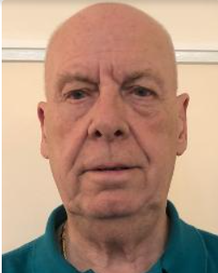
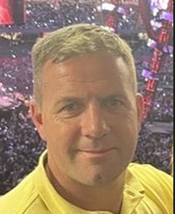
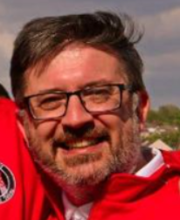
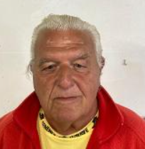
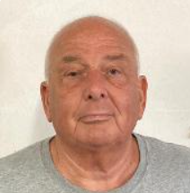
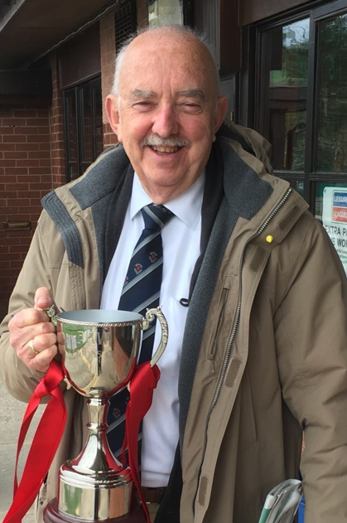
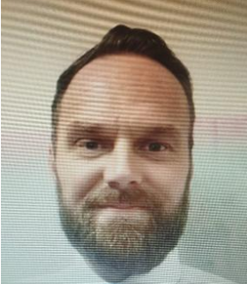

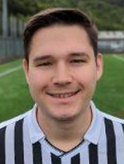
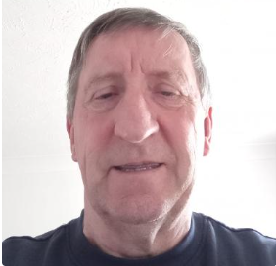


Cardiff Draconians FC Directors & Committee
Dave Rees
Chairman &
Director
Nick Driscoll Secretary &
Director
Paul Yanez
Treasurer &
Director
Chris Stephens
Vice Chairman
Steve Haines
Life President
Dan Cope
Junior Secretary & Director
Paul Jennings
Committee /Life Member
Colin Ashton
Committee &
Director
Gareth Williams
Community Development Officer & Director
Helen Bright Safeguarding & Welfare officer
Connor Bickford
Finance Officer

